Slide 1

TEAM-7 CAPSTONE PROJECT
Profile Book
“Keep people connected virtually”

Slide 2
TEAM-7 (Profile page) Team Members
Tarone Yogeshri Mulchand(52129502)
Tere Bhargavi(52120616)
Ujji Monika(52123724)
Uppala Usha Sai Kiran(52129503)

Slide 3
PROJECT OBJECTIVE ADMIN STORY USER STORY
Admin Register, Login, Logout
Admin HomePage
User CRUD
Post CRUD
Approval Post
Reported Users
User Register, Login, Logout
User HomePage
Share Post
Messege Other User
Search any User
Report another User

Slide 4



Software Requirement and connectivity

Slide 5
Admin Block Diagram
Welcome Page
Admin Registration
Admin Login
Admin HomePage
Posts
Users
Reported Users
Sign Out
Able to see all posts by user
User Post Approval
Lists Of Users
Lists Of Reported Users

Slide 6

Welcome Page

Slide 7
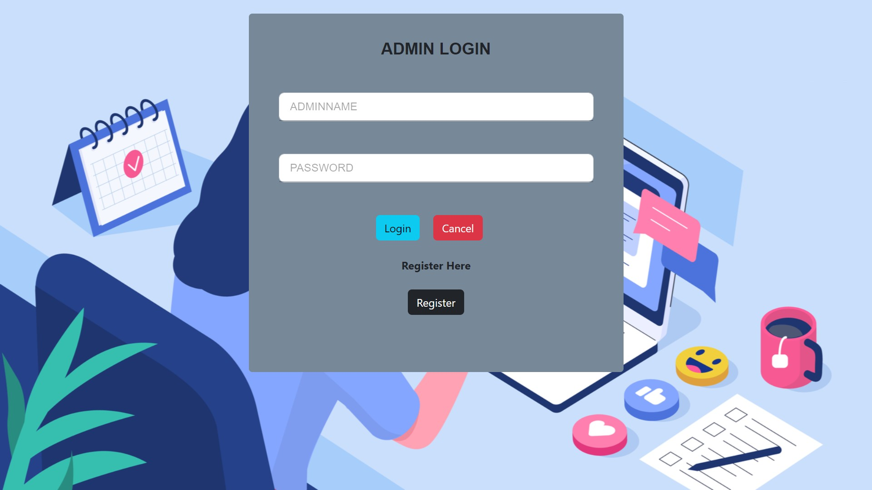
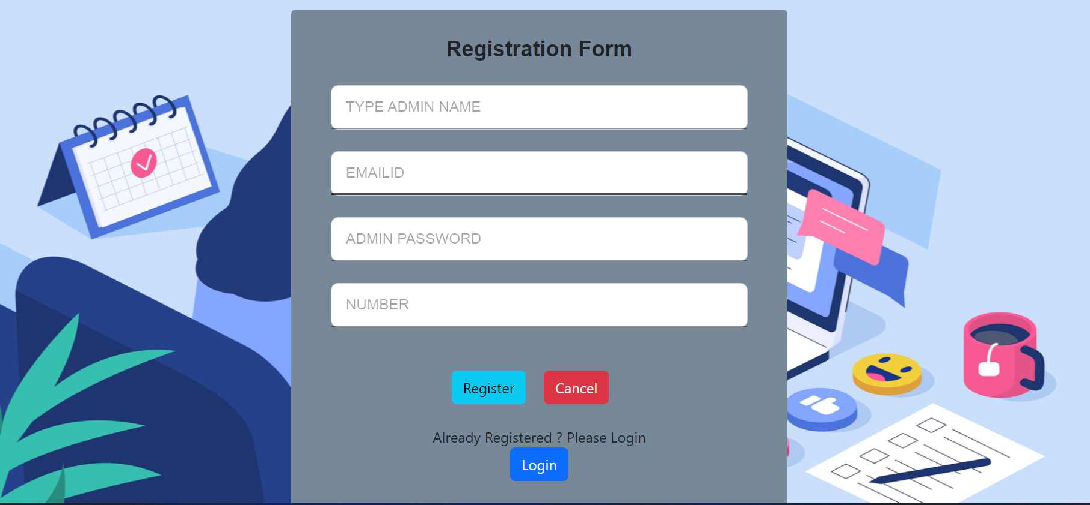
Admin

Slide 8
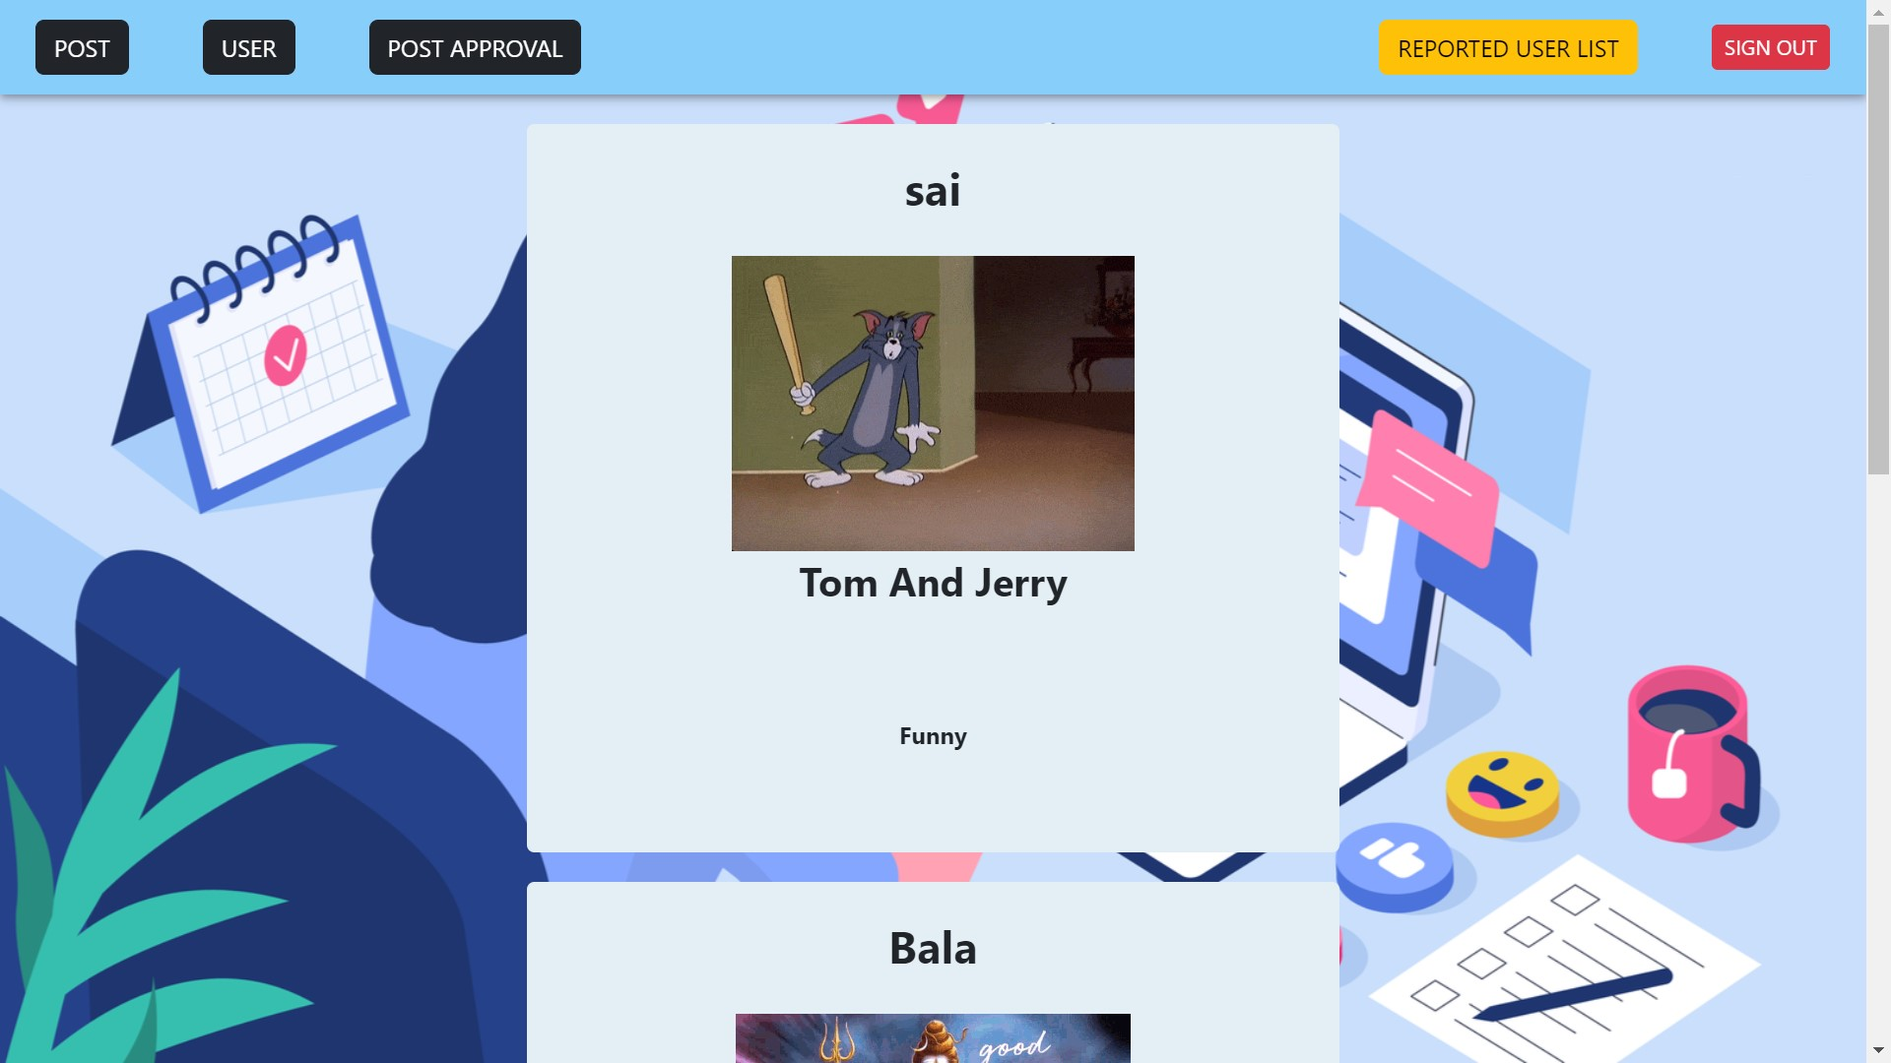
Admin HomePage

Slide 9
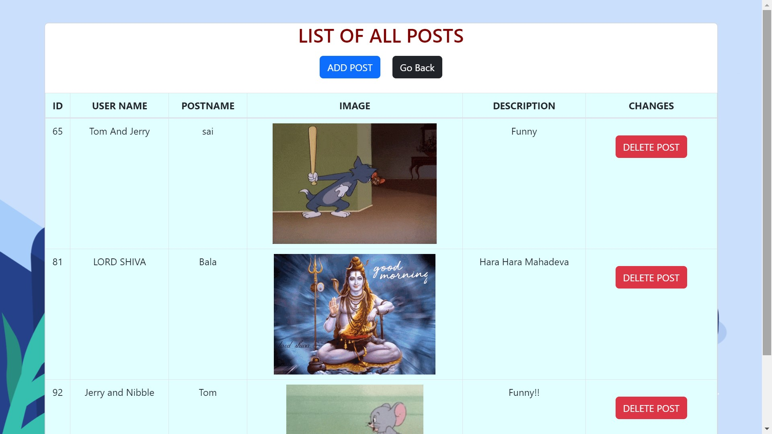
Admin Post CRUD

Slide 10
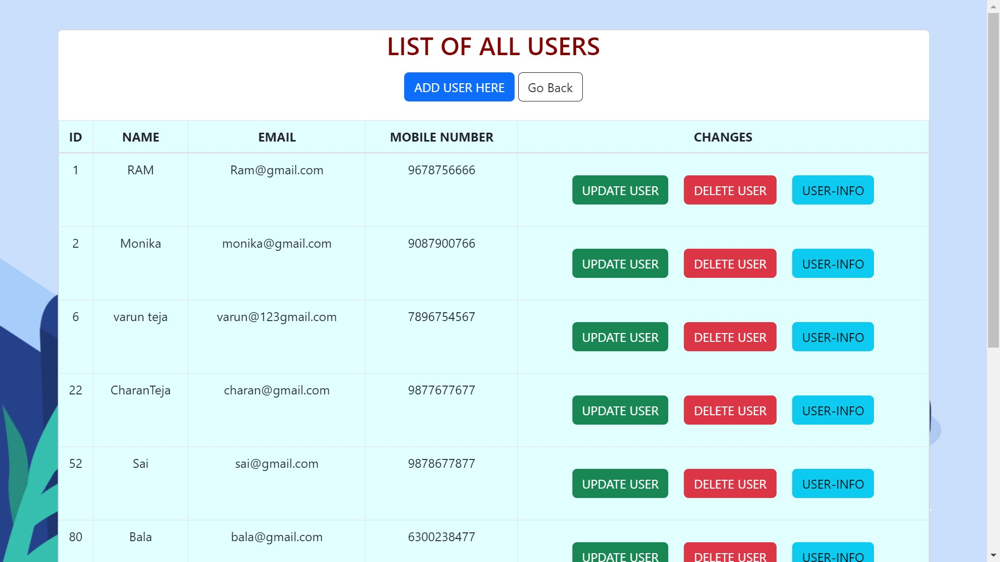
Admin User CRUD

Slide 11
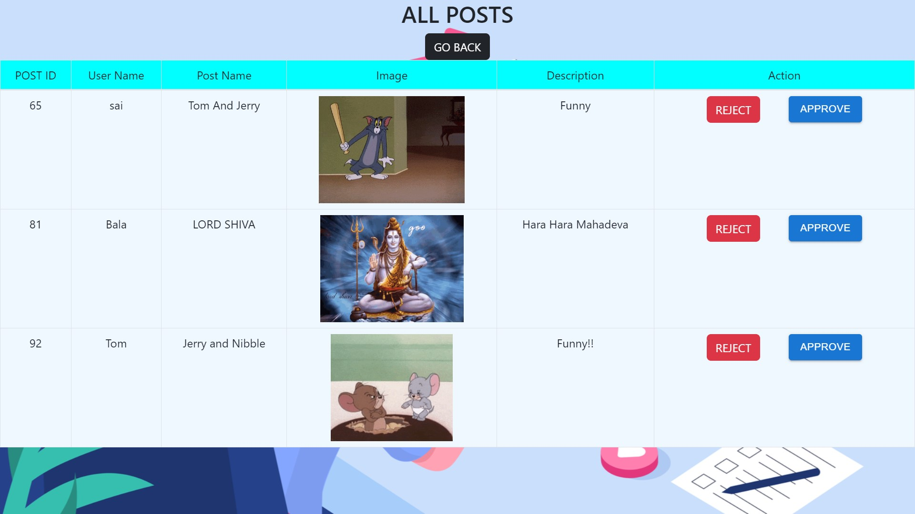
Admin Post Approval

Slide 12
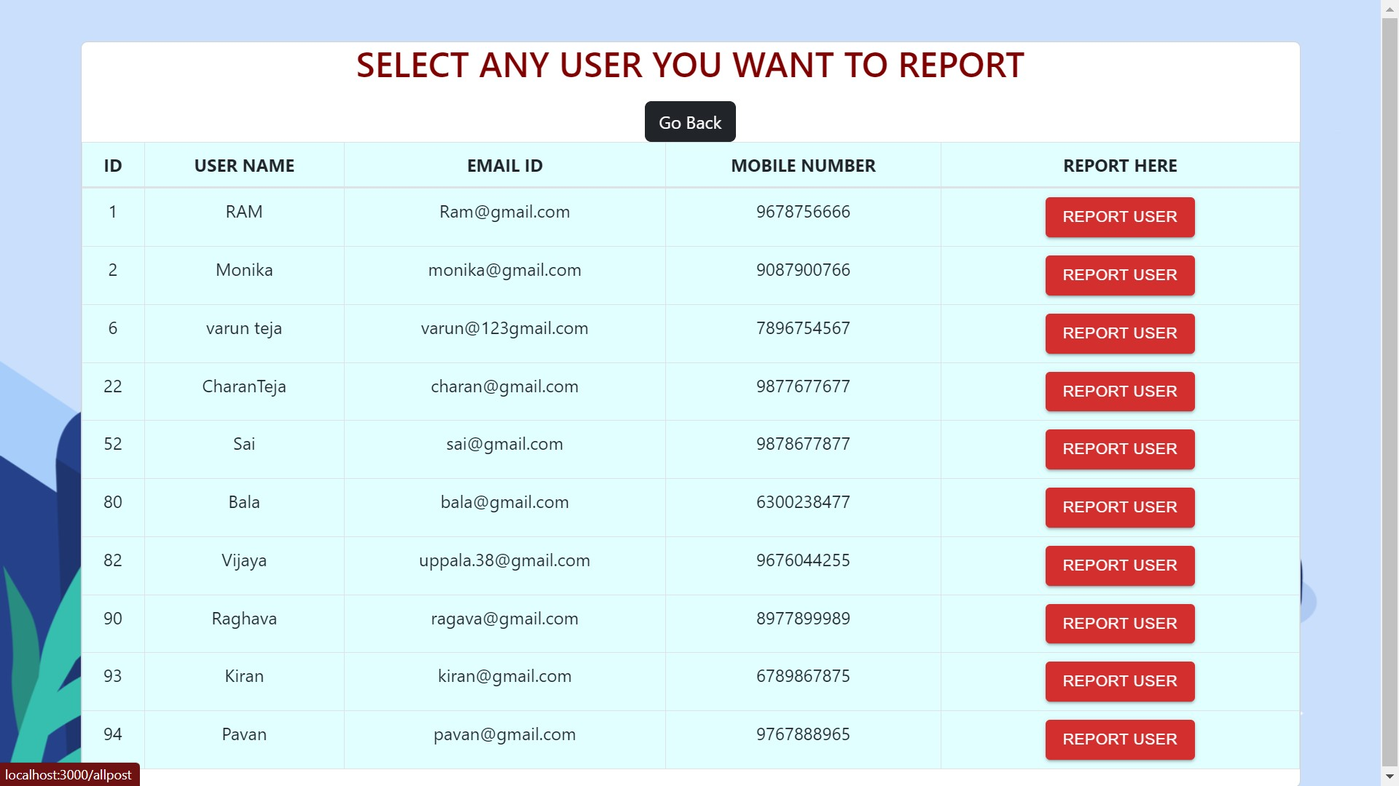
Reported Users

Slide 13
User Block Diagram
Welcome Page
User Registration
User Login
User HomePage
Posts
Report User
Sign Out
Add Posts
Edit Post
Delete Post
Report Other User
Get All Posts

Slide 14
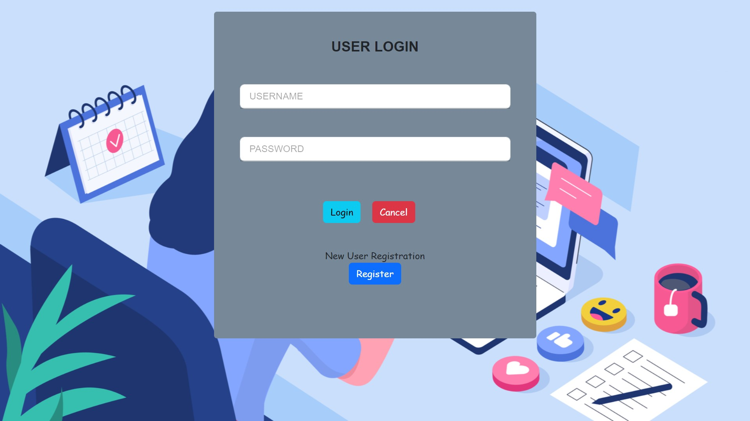
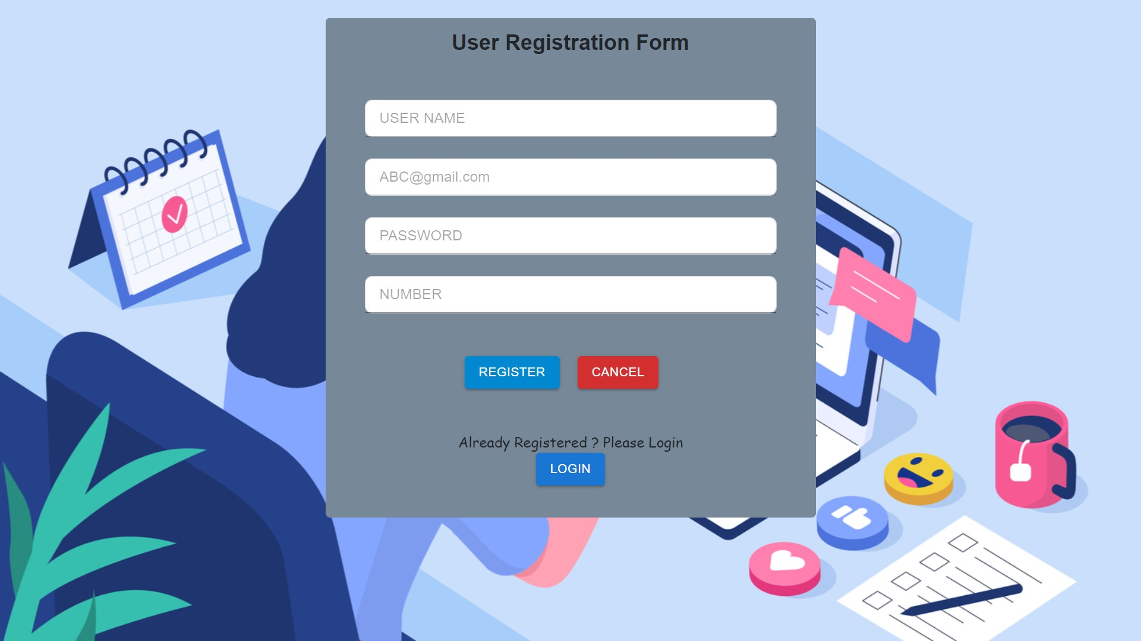
USER

Slide 15
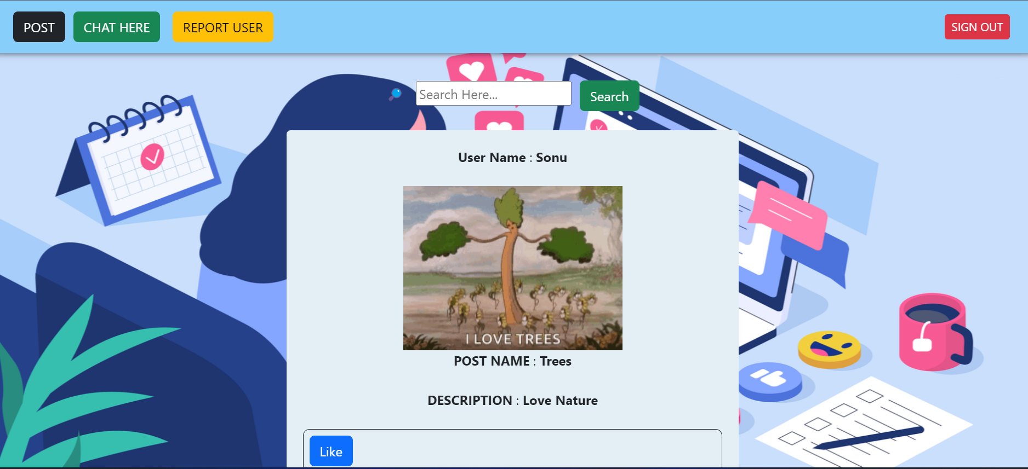
User HomePage

Slide 16
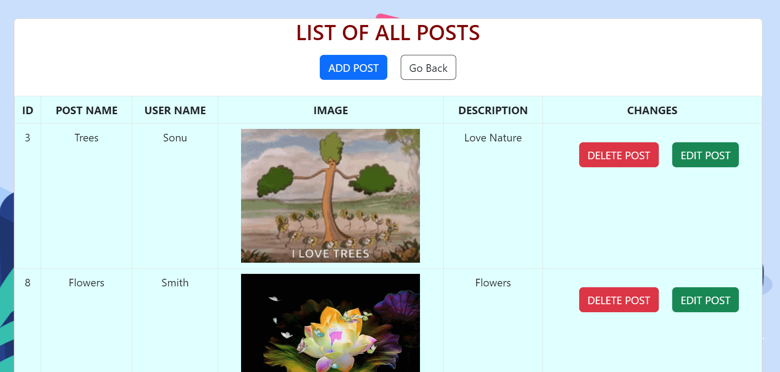
User Post CRUD

Slide 17
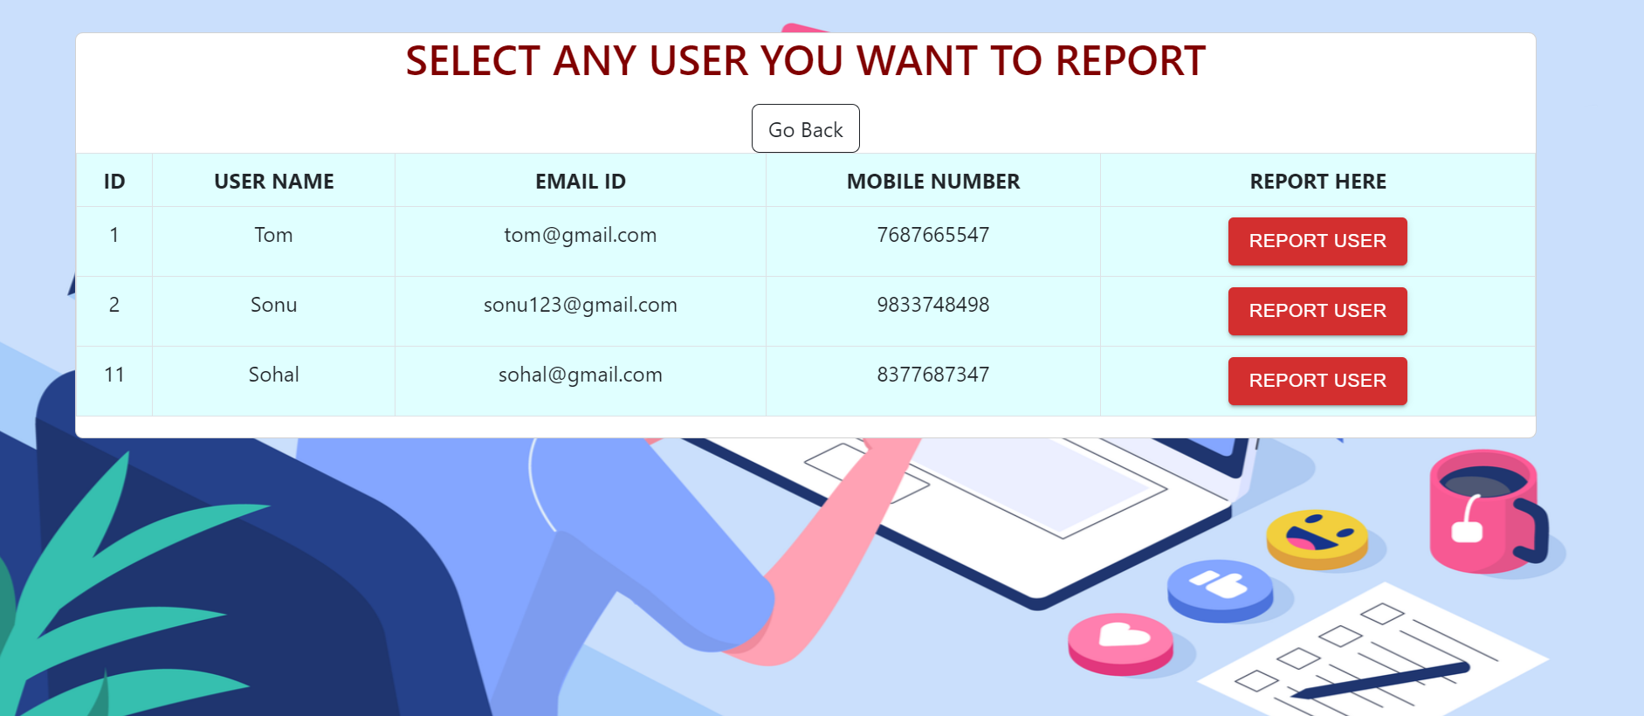
User Report Another User

Slide 18


